Slide 1
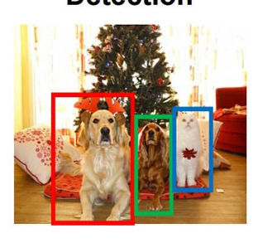
What is Object Detection ?
Computer vision technique
Identifies and locates objects within an image or video
Draws bounding boxes around these detected objects which allow us to locate where said objects are in (or how they move through) a given scene.

Slide 2
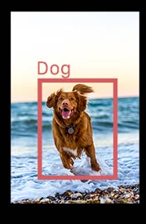
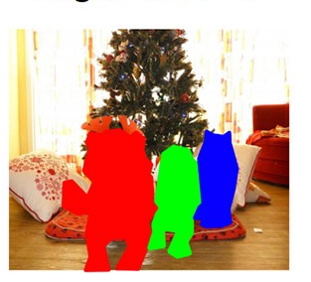
NOT to be confused with Object/Image classification or Image segmentation.
Image Classification
Adds a label
Image Segmentation
Tells us about the actual shape

Slide 3
Types of Object Detection
Non-neural approaches:
Viola–Jones object detection framework based on Haar features
Scale-invariant feature transform (SIFT)
Histogram of oriented gradients (HOG) features
Neural network approaches:
Region Proposals (R-CNN, Fast R-CNN, Faster R-CNN,cascade R-CNN)
Single Shot MultiBox Detector (SSD)
You Only Look Once (YOLO)
Single-Shot Refinement Neural Network for Object Detection (RefineDet) [14]
Retina-Net
Deformable convolutional networks

Slide 4
Haar Cascade
Introduced in 2001 by Viola and Jones
The algorithm uses edge or line detection features
Pretrained Models - https://github.com/opencv/opencv/tree/master/data/haarcascades
Custom Training - https://docs.opencv.org/3.4/dc/d88/tutorial_traincascade.html

Slide 5
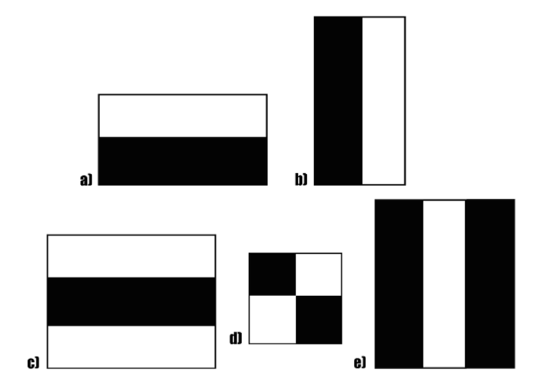
Haar Features
These features on the image makes it easy to find out the edges or the lines in the image, or to pick areas where there is a sudden change in the intensities of the pixels.
The first set of two rectangle features(a,b) are responsible for finding out the edges in a horizontal or in a vertical direction. The second set of three rectangle features(c,e) are responsible for finding out if there is a lighter region surrounded by darker regions on either side or vice-versa. The third set of four rectangle features(d) are responsible for finding out change of pixel intensities across diagonals.

Slide 6
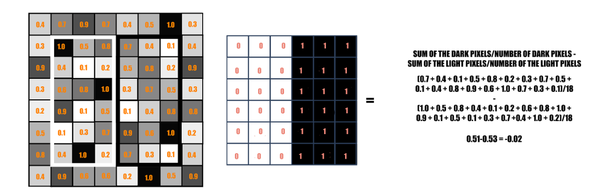
Haar value
We can say that there is an edge detected if the haar value is closer to 1.

Slide 7
The Integral Image
To bypass the Exhaustive process

Slide 8
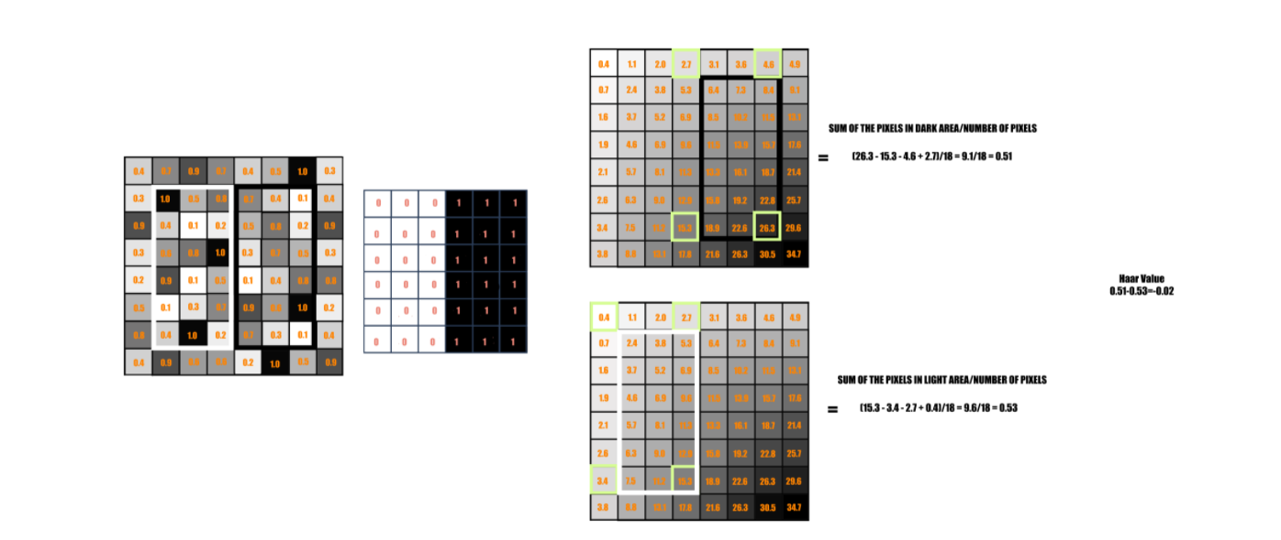

Slide 9
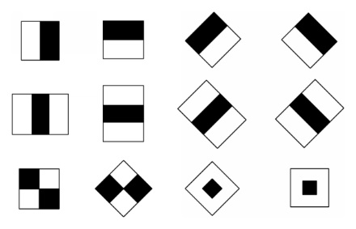
AdaBoost (Adaptive Boosting)
The feature set had an approx. of 180,000 of them, which got reduced to 6000.
A majority of these features won’t work well or will be irrelevant to the facial features
Feature Selection technique
180,000 features were applied to the images separately to create Weak Learners
With this technique, their final set of features got reduced to a total of 6000 of them.

Slide 10
Attentional Cascade
6000 features will again run on the training images to detect if there’s a facial feature.
Standard window size of 24x24
Not all the features need to run on each and every window.
Features are applied on the images in stages.
The second stage processing would start, only when the features in the first stage are detected in the image.

Slide 12
Total 38 stages for approx. 6000 features.
The number of features in the first five stages are 1, 10, 25, 25, and 50, and this increased in the subsequent stages.

Slide 13
Document Scanner
Step 1: Detect edges.
Step 2: Use the edges in the image to find the contour (outline) representing the piece of paper being scanned.
Step 3: Apply a perspective transform to obtain the top-down view of the document.

Slide 14
Thank You

